Slide 1

Quick Apps Score New Applicants
Presented by:
Oleh Sosnytskyi, Data Science
Update: 04th August 2025

Slide 2
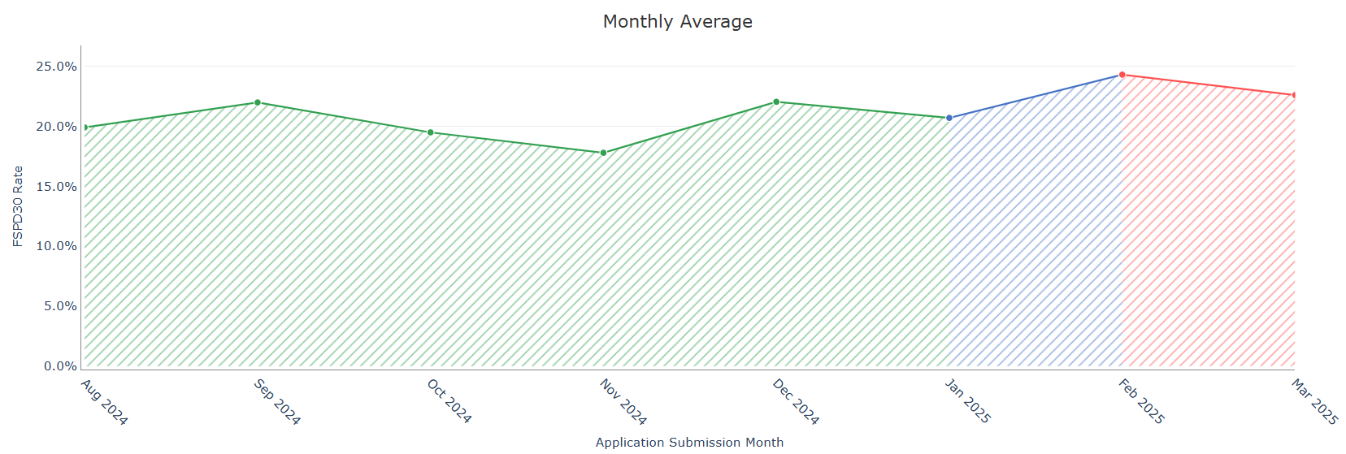
Train-test split. Target definition.
Period | Appication submission dates | # Records | # FSPD30 Count | # FSPD30 Rate
Training | Aug 13, 2024 – Jan 31, 2025 | 6 894 | 1 390 | 0.202
OOT 1 | Feb 2025 | 1 054 | 256 | 0.243
OOT 2 | Mar – Apr 16, 2025 | 1 146 | 256 | 0.223
The training dataset and test datasets only contains New Applicants.
Target: FSPD30

Slide 3
Features: feature selection pipeline
190
Feats
131
Feats
124
Feats
22
Feats
8
Feats
IV > 0.001 (num)
IV > 0.02 (cat)
Pairwise correlation
< 0.9
Stable feature patterns across train/test/oot periods
Final feature set
So, in the end, all selected features are those that: 1. do not have high correlation
2. do not have high % of missed values
3. do not have rare categories
4. stable correlation with target across all periods

Slide 4
Selected features. List ordered by feature importance.
# | Feature Name | Description
1 | app_cnt_health_and_fitness_ever | Number of Health & Fitness applications
2 | app_cnt_shopping_ever | Number of Shopping applications
3 | app_avg_time_bw_installed_mins_3d | Average time between application installations in minutes in last 3 days
4 | app_median_time_bw_installed_mins_ever | Median time between application installations in minutes ever
5 | app_cnt_crypto_ever | Number of crypto applications
6 | app_cnt_payday_180d | Number of Payday applications in last 180 days
7 | app_cnt_driver_ever | Number of Driver applications
8 | app_cnt_gambling_180d | Number of Gambling applications in last 180 days

Slide 5
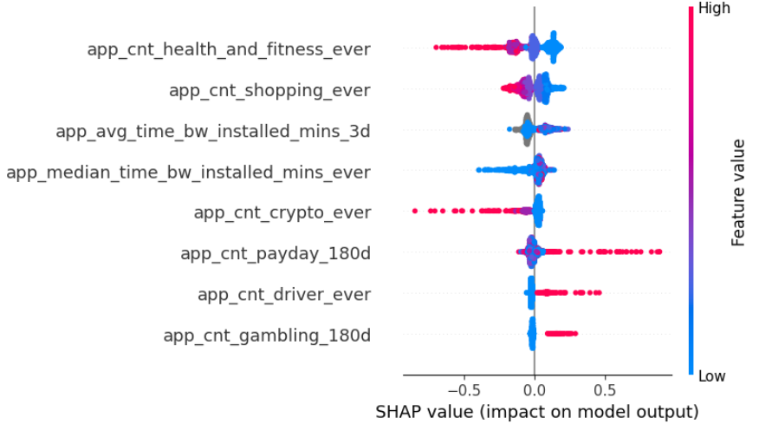
Feature importance of selected features
How to Read this SHAP chart?
Impact on default probability:
Values to the right (positive) → increase probability of default
Values to the left (negative) → decrease probability of default
Features at the top have strongest influence on predicting defaults
Red color means High feature value, Blue color means low feature value, so
Right Red: high values of this feature increases default risk
Left Blue: low values of this feature decreases default risk
Right Blue: low values of this feature increased default risk
Left Red: high values of this feature decreases default risk

Slide 6
CatBoost Model Performance. Incremental Gini Analysis
Model iteration | Features | Train Gini | OOT 1 Gini | OOT 2 Gini
Final features (8 features) | Final features | 0.3132 | 0.2536 | 0.2482
Top 9 features | + app_cnt_rated_for_18plus_ever | 0.3427 | 0.2538 | 0.2561*
Top 10 features | + app_last_payday_install_to_apply_days | 0.36 | 0.2768 | 0.2411
Top 11 features | + app_cnt_lifestyle_ever | 0.3575 | 0.2626 | 0.2278
Top 7 features | - app_cnt_gaming_180d | 0.2908 | 0.2668 | 0.2224
Top 6 features | - app_cnt_books_and_reference_ever_binned | 0.2729 | 0.2577 | 0.2198
Top 9 vs Top 8 features were also compared using Apr only data (Apr 1 – Apr 16) to compare model performance on most recent data. The difference was significant: Top 8 feat (current) model 0.2464 vs 0.1744 Top 9 feat model.
The best number of features based on OOT 1/OOT 2 performance and stability is 8 features.

Slide 7
Apps Score Model Performance
Model | Train Gini [Aug 13 – Jan 31] | OOT 1 Gini [Feb 1 – Feb 28] | OOT 2 Gini [Mar 1 – Apr 16] | OOT 3 Gini [FPD30, May 1 – May 16]
CatBoost model | 0.313 | 0.254 | 0.248 | 0.262
DL model | 0.688 | 0.343 | 0.332 | 0.351
Combined model (0.45/0.55 weights) | 0.682 | 0.363 | 0.357 | 0.399
Old model | 0.279 | 0.342 | 0.271 | 0.264

Slide 8
Appendix
​
tonikbank.com

Slide 9
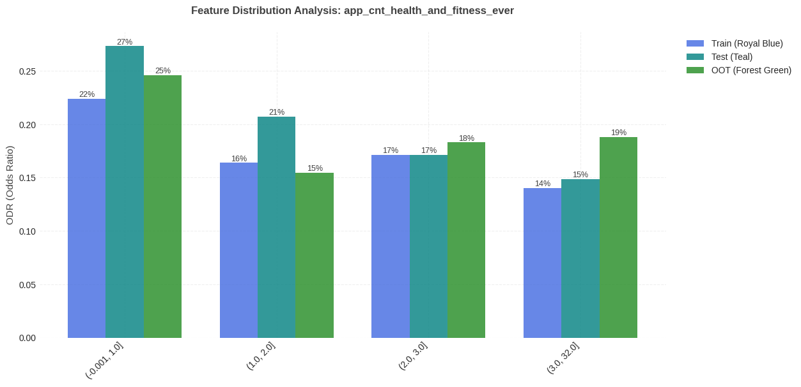
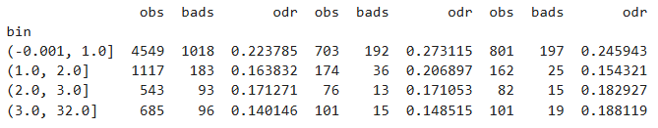
#1 app_cnt_health_and_fitness_ever: feature distribution per train/test
There is a trend where bin [0,1] always has a higher ODR than the other bins.

Slide 10
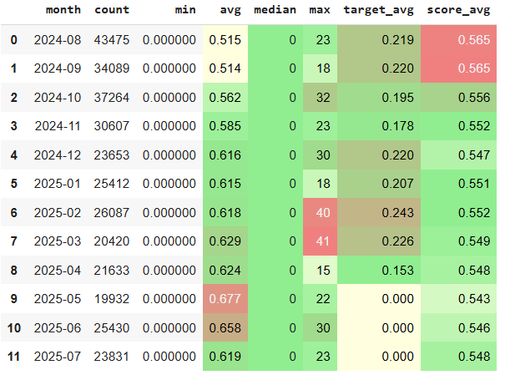
#1 app_cnt_health_and_fitness_ever: MoM feature statistic
The average feature value shows small spikes in May–June 2025, which may have contributed to a slight (< –0.9%) change in the average score during these months
Apart from this, the average value has remained stable over the past eight months

Slide 11
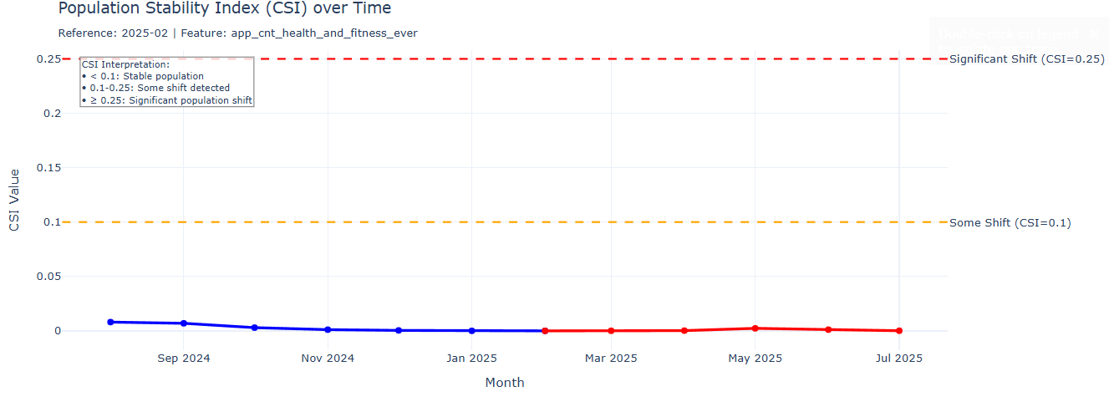
#1 app_cnt_health_and_fitness_ever: feature CSI Analysis
The CSI value stayed below 0.1 throughout Aug 2024–Jul 2025, indicating that the feature’s distribution remained largely unchanged and stable.

Slide 12
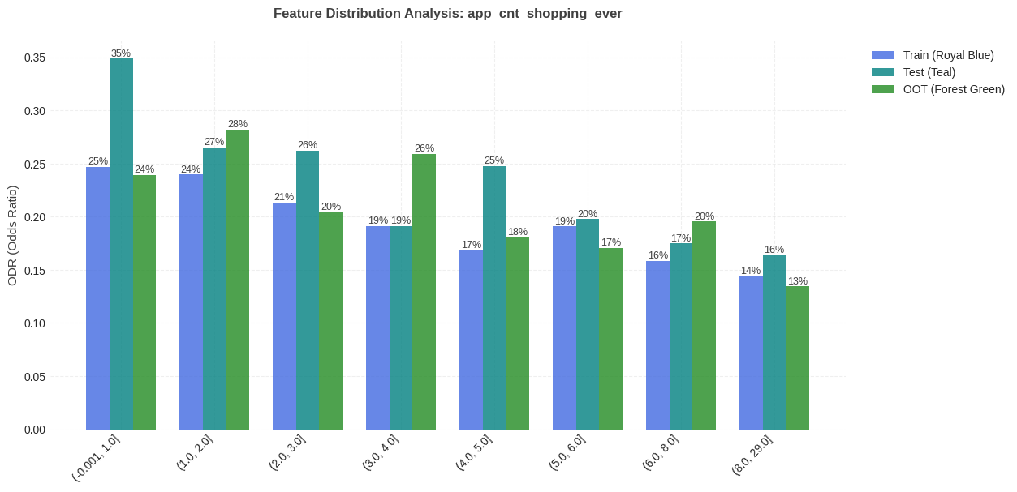
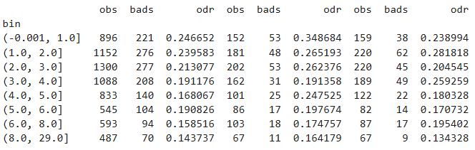
#2 app_cnt_shopping_ever: feature distribution per train/test
There is a trend: lower count corresponds to higher ODR.

Slide 13
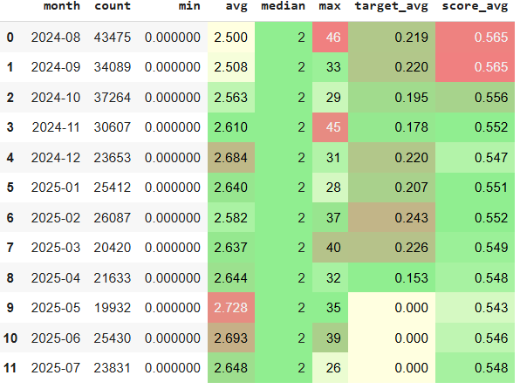
#2 app_cnt_shopping_ever : MoM feature statistic
The average feature value shows small spikes in May–June 2025, which may have contributed to a slight (< –0.9%) change in the average score during these months
Apart from this, the average value has remained stable over the past eight months

Slide 14
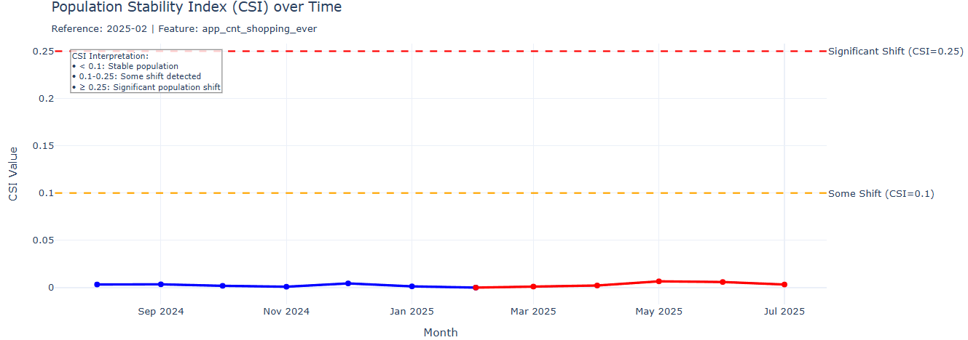
#2 app_cnt_shopping_ever : feature CSI Analysis
The CSI value stayed below 0.1 throughout Aug 2024–Jul 2025, indicating that the feature’s distribution remained largely unchanged and stable.

Slide 15
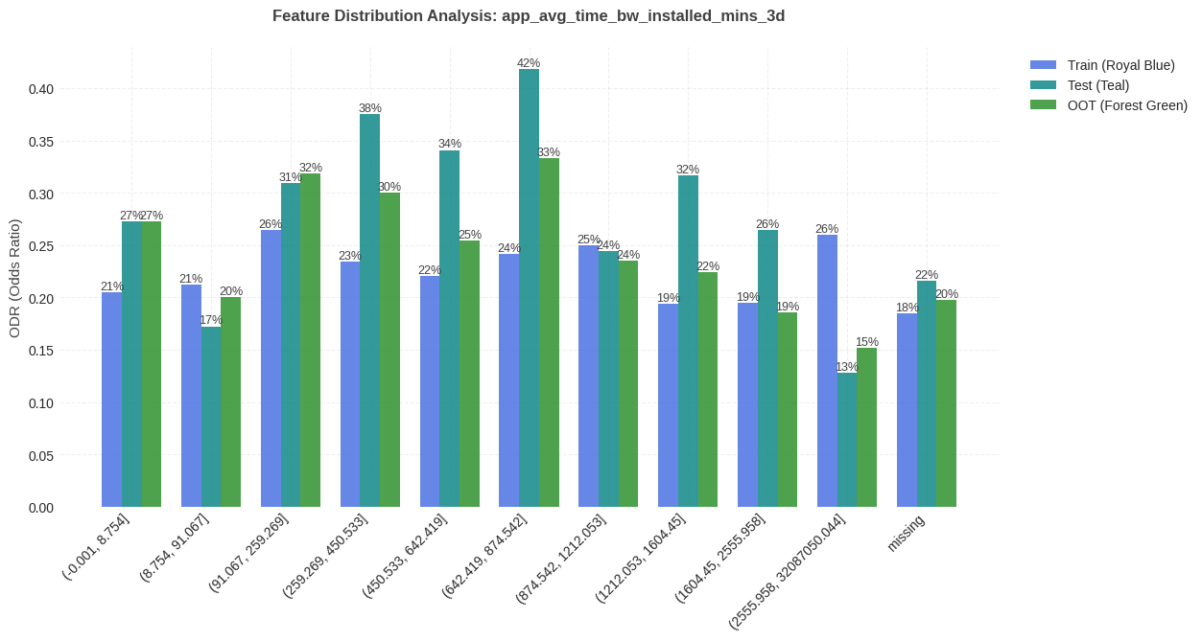
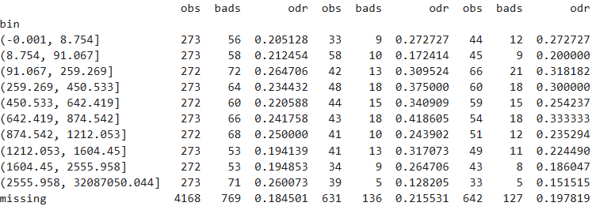
#3 app_avg_time_bw_installed_mins_3d: feature distribution per train/test
There is a subtle inverse U-shape trend

Slide 16
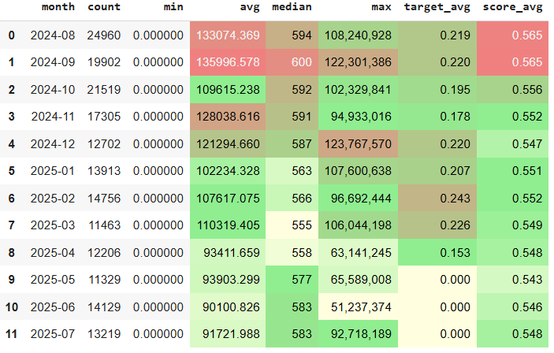
#3 app_avg_time_bw_installed_mins_3d : MoM feature statistic
Starting in April 2025, the average feature value dropped by approximately 15%, due to a change in the logic for obtaining data on installed applications, which affected the number of extreme values. At the same time, the median remained approximately stable, with only minor fluctuations throughout the entire period.

Slide 17
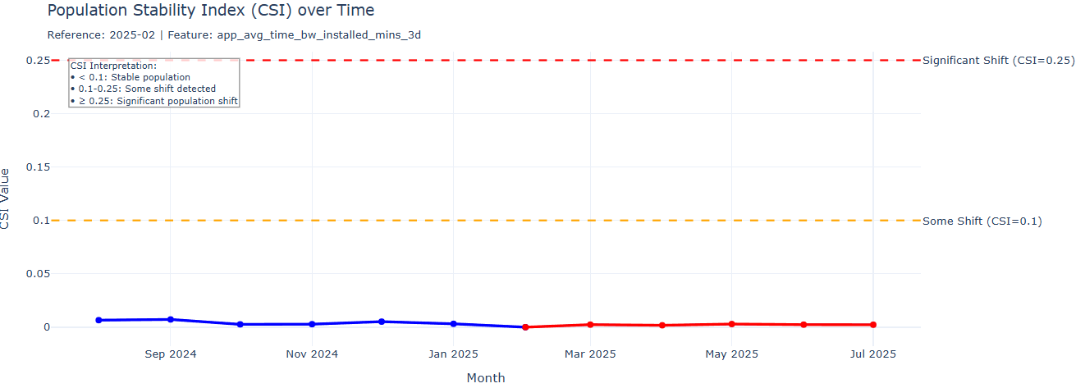
#3 app_avg_time_bw_installed_mins_3d: feature CSI Analysis
The CSI value stayed below 0.1 throughout Aug 2024–Jul 2025, indicating that the feature’s distribution remained largely unchanged and stable.

Slide 18
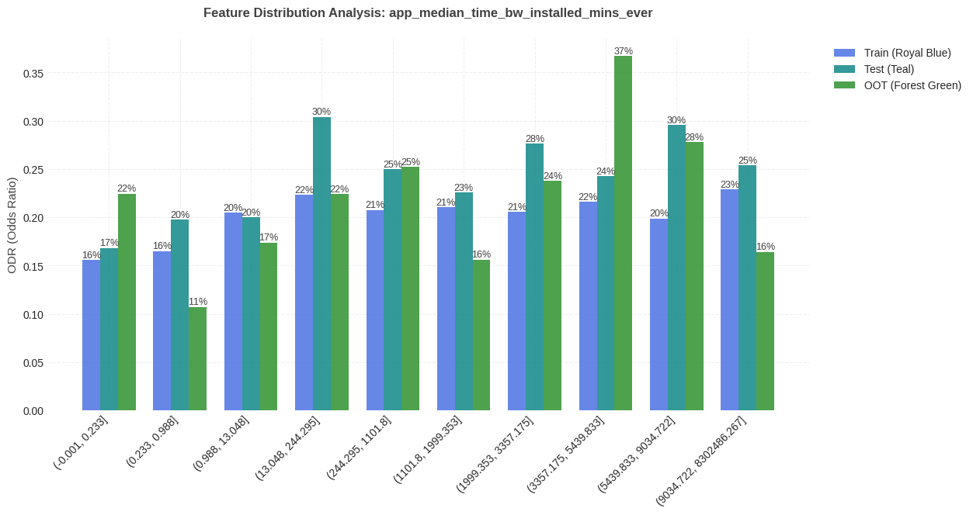
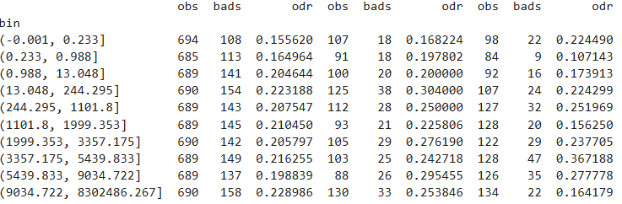
#4 app_median_time_bw_installed_mins_ever: feature distribution per train/test
There is a trend: lower count corresponds to lower ODR.

Slide 19
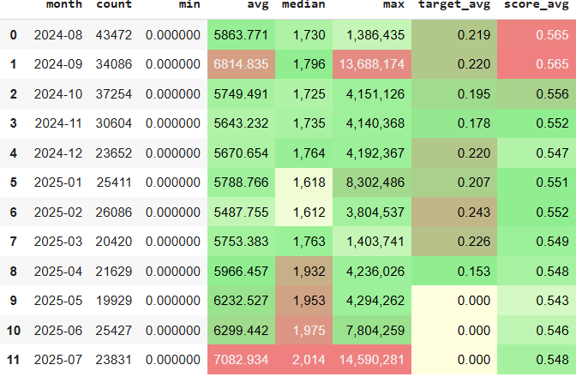
#4 app_median_time_bw_installed_mins_ever: MoM feature statistic
Since April 2025, the average and median feature values have gradually risen by about 10–20%, possibly due to changes in the logic for collecting installed app data. This does not appear to have affected the average score for the month.

Slide 20
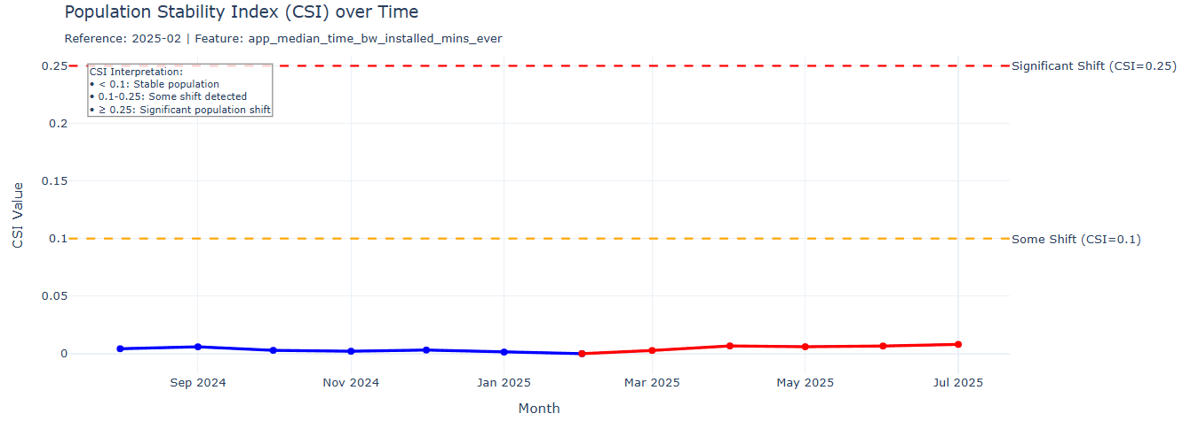
#4 app_median_time_bw_installed_mins_ever: feature CSI Analysis
The CSI value stayed below 0.1 throughout Aug 2024–Jul 2025, indicating that the feature’s distribution remained largely unchanged and stable.

Slide 21
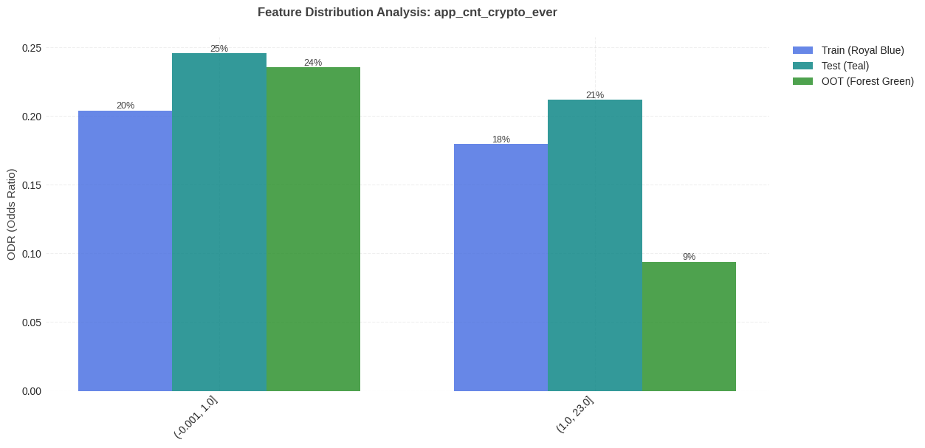

#5 app_cnt_crypto_ever: feature distribution per train/test
There is a trend: lower count corresponds to higher ODR.

Slide 22
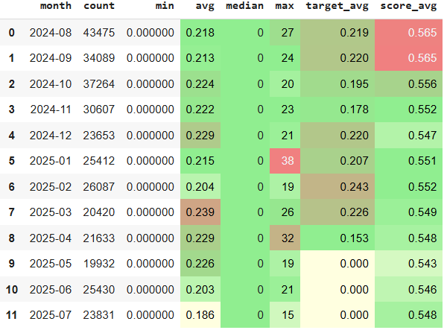
#5 app_cnt_crypto_ever: MoM feature statistic
The mean and median appear stable throughout the entire period under review, with minor fluctuations, except for the last two months, where the mean dropped by approximately 10%.

Slide 23
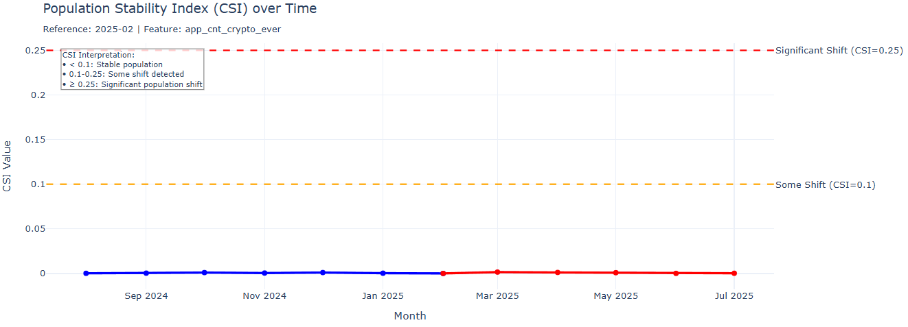
#5 app_cnt_crypto_ever: feature CSI Analysis
The CSI value stayed below 0.1 throughout Aug 2024–Jul 2025, indicating that the feature’s distribution remained largely unchanged and stable.

Slide 24
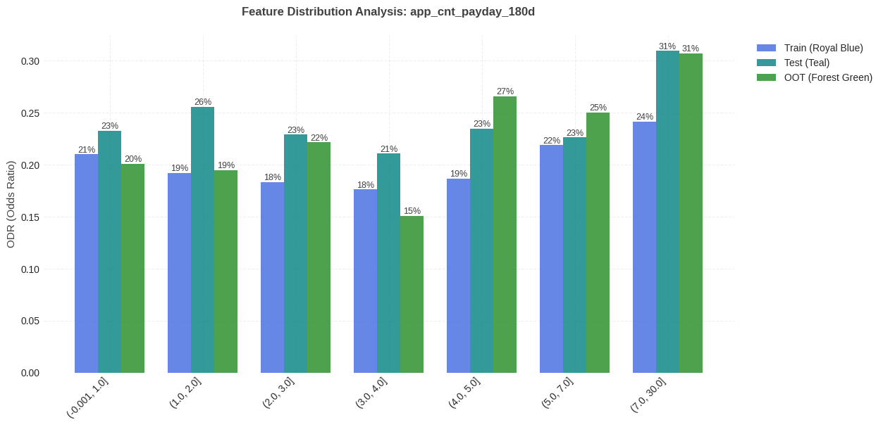
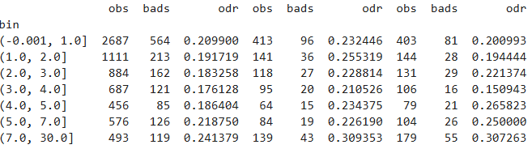
#6 app_cnt_payday_180d: feature distribution per train/test
There is a weak trend here: higher ODR for higher feature values.

Slide 25
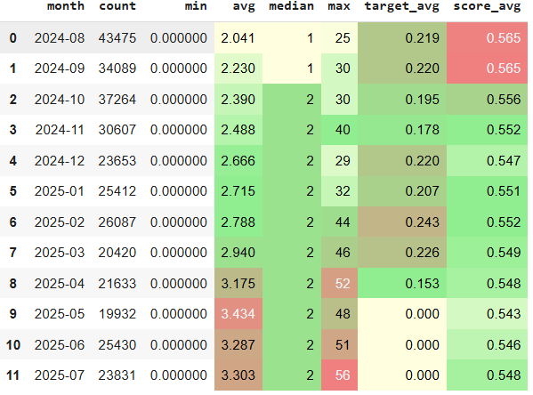
#6 app_cnt_payday_180d: MoM feature statistic
The mean gradually increased by approximately 10% starting from April 2024, while the median remained stable; however, it cannot be said that this affected the model's average score

Slide 26
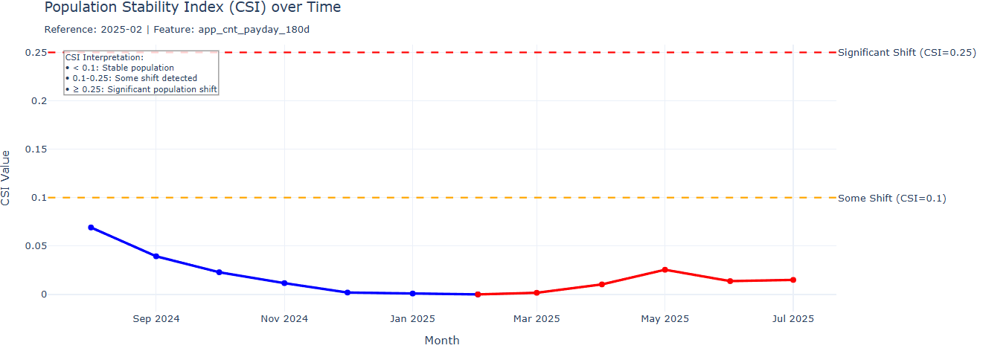
#6 app_cnt_payday_180d: feature CSI Analysis
The CSI value stayed below 0.1 throughout Aug 2024–Jul 2025, indicating that the feature’s distribution remained largely unchanged and stable.

Slide 27
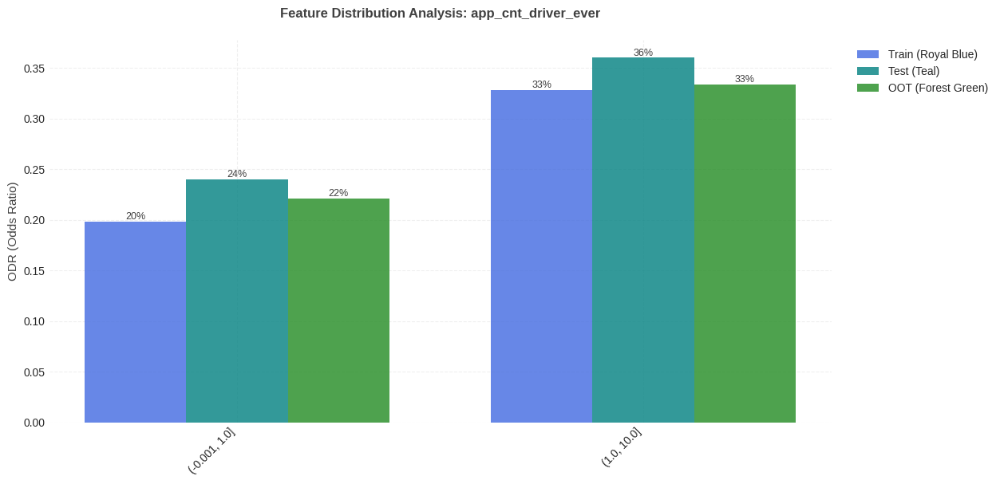

#7 app_cnt_driver_ever: feature distribution per train/test
There is a trend: lower count corresponds to lower ODR.

Slide 28
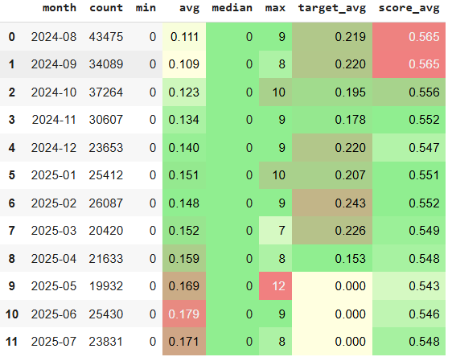
#7 app_cnt_driver_ever: MoM feature statistic
The mean gradually increased by approximately 10% starting from April 2024, while the median remained stable; however, it cannot be said that this affected the model's average score

Slide 29

#7 app_cnt_driver_ever: feature CSI Analysis
The CSI value stayed below 0.1 throughout Aug 2024–Jul 2025, indicating that the feature’s distribution remained largely unchanged and stable.

Slide 30
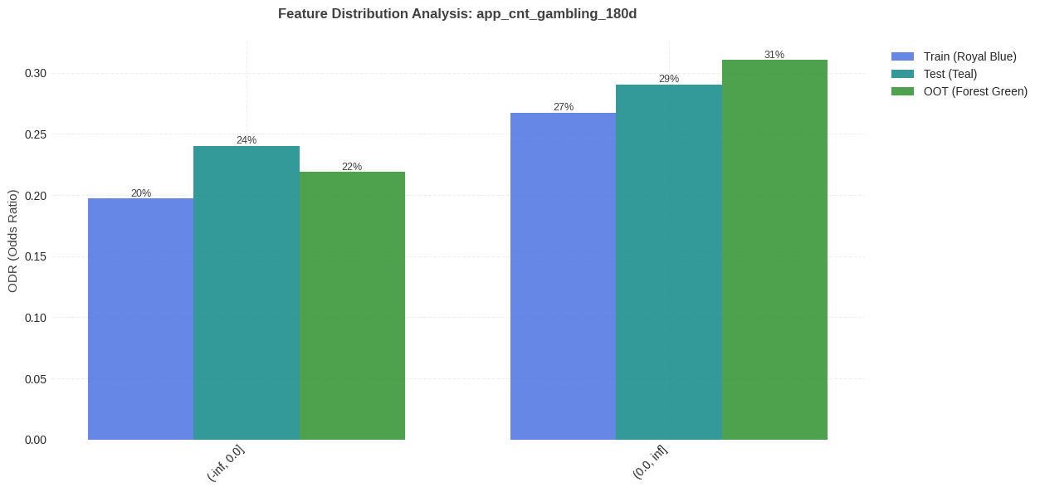

#8 app_cnt_gambling_180d: feature distribution per train/test
There is a trend: lower count corresponds to lower ODR.

Slide 31
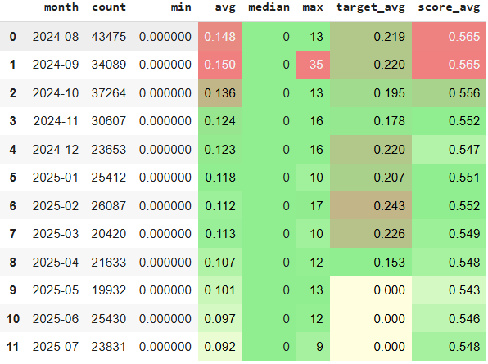
#8 app_cnt_gambling_180d: MoM feature statistic
A decreasing trend in the feature's mean is observed throughout the period, while the median remains stable. Since this trend is not reflected in the model's average score, we can conclude that the impact of the feature's decreasing mean on the score is negligible

Slide 32
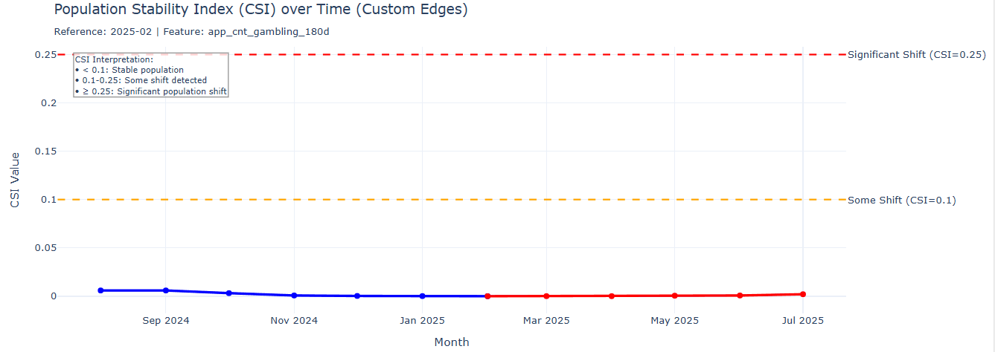
#8 app_cnt_gambling_180d: feature CSI Analysis
The CSI value stayed below 0.1 throughout Aug 2024–Jul 2025, indicating that the feature’s distribution remained largely unchanged and stable.

